Slide 1

Chilling out in the Bahamas
Notes:
(pause: 2)

Slide 2
Notes:
(voice: amber)
(narration-mode: merge)
The climate of The Bahamas is mostly tropical, with two seasons. One hot and wet, and the other warm and dry. The low latitude, warm tropical Gulf Stream, and low elevation give The Bahamas a warm and winterless climate. In 2016, over 3 million tourists visited the Bahamas, most of whom are from the United States and Canada.

Slide 3


Slide 4


Slide 5


Slide 6


Slide 7


Slide 8


Slide 9

Notes:
(narration-mode: normal)

Slide 10
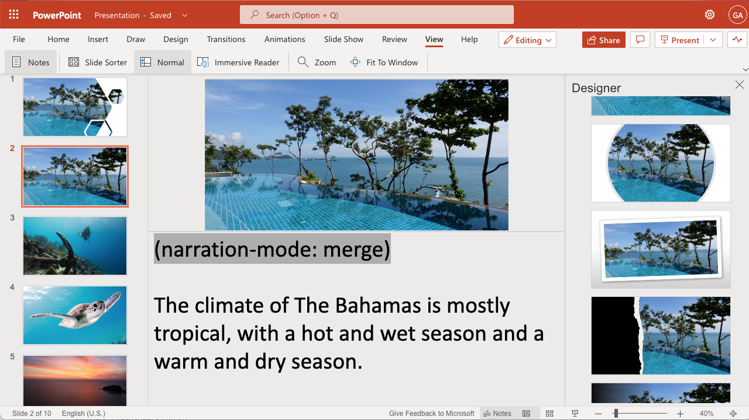
Notes:
(voice: Rodney)
Create videos like this one easily with Narakeet, using natural and realistic text to speech voices. Just type the voiceover text into speaker notes, upload your slides and let Narakeet do the rest.

Slide 11
Narakeet.com
Notes:
(voice: Rodney)
For more information, check out Narakeet.com

